Slide 1
Visualizing and Exploring Data

Slide 2
Content
Plotting data on chart
Column, bar, line, pie….
Extracting data from database
Sorting and filtering
Manipulating and summarizing data
Pivot table

Slide 3
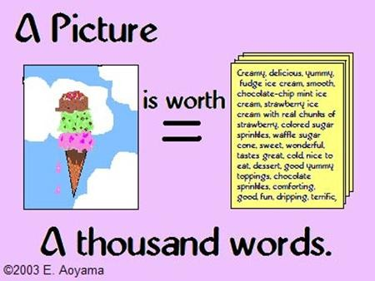
Data Visualization
A way of communicating data. It can reveal surprising patterns and relationships.
It is important for building decision models and for interpreting their results.
Techniques for doing this ranges from
Plotting data charts
Extracting data from databases and
Manipulating and summarizing data

Slide 4
Creating Chart
Highlight the range of data.
Select the insert tab.
Click on chart type, then subtype.
Use chart tools to customize the chart.
Design tab to change the type of chart, data included in the chart, chart layout and styles.
Layout tab to modify the layout of titles and labels, axes and grid-lines and other features.
Format tab provides various formatting options.

Slide 5
Column and Bar Charts
Excel distinguishes between vertical and horizontal bar chart, calling the former columns charts and the latter bar charts.
A clustered column chart compares values across the categories using vertical rectangles
A stacked column chart displays the contribution of each value to the total by stacking the rectangles and
A 100% stacked column chart compares the percentage that each value contributes to a total.

Slide 6
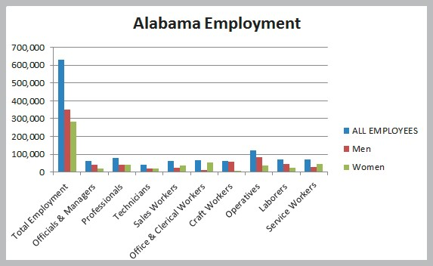
Creating a Column Chart using Excel
The Excel file EEO Employment Report provides data on the number of employees in different categories broken down by racial/ethnic group and gender.
We will construct a simple bar chart for the various employment categories for all employees.

Slide 7
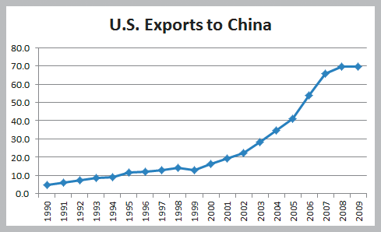
Line Chart
It provides a useful means for displaying data over time.
We may plot multiple data series in line charts.
A line chart giving the amount of US exports to China in billions of dollars.
– From China Trade Data Excel file

Slide 8
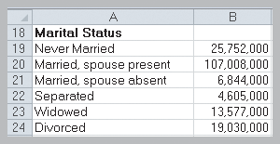
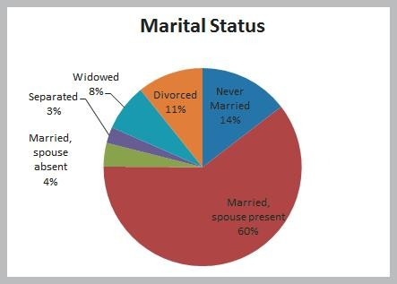
Pie Chart
A pie chart displays relative proportion of each data source to the total by partitioning a circle into pie-shaped areas showing the relative proportion.
The relative proportion in each category of marital status of individuals in
the US population using Census Education Data excel file.
Figure 3.8

Slide 9
Area Chart
An area chart combines the features of a pie chart with those of line chart.
Total energy consumption (billion Btu) and consumption of fossil
fuels using Energy Production & Consumption Excel file.
Chart Title
200
180
160
140
120
100
80
60
40
20
0
Axis Title
Total Energy Consumption Fossil Fuels Consumption
1949
1954
1959
1964
1969
1974
1979
1984
1989
1994
1999
2004
2009

Slide 10
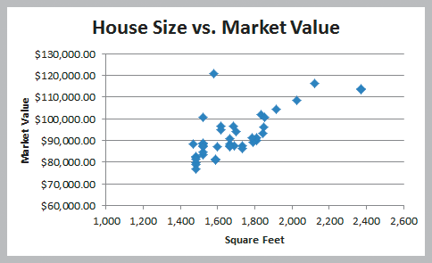
Scatter Chart
It show the relationship between two variables. To construct a scatter, we need observations that consist of pairs of variables.
A scatter chart of house size (in square feet) versus the home market value from the Excel file Home Market Value.

Slide 11
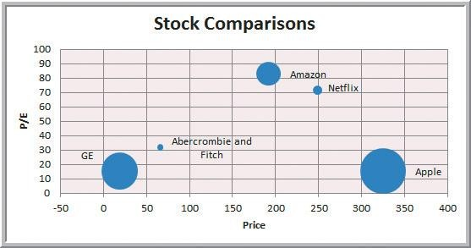
Bubble Chart
A bubble chart is a type of scatter chart in which the size of the data marker corresponds to the value of a third variable
It is a way to plot three variables in two dimensions.
A bubble chart for displaying price, P/E (price/earnings) ratio, and market capitalization for five different stocks on one particular day in the Excel file Stock Comparison.

Slide 12
Miscellaneous Excel Charts
Stock chart: allows to plot stock prices, such as the daily high, low and close. It may also be used for scientific data such as temperature change.
Surface chart: shows three dimensional data
Doughnut chart: like pie chart but can contain more than one data series
Radar chart: allows you to plot multiple dimensions of several data series.
Geographic mapping: available through Microsoft MapPoint 2010. It is a geographic data mapping tool to visualize data imported from Excel and other data sources.

Slide 13
Sorting data in Excel
The sorting options can be found under the Data tab in the Sort & Filter group.
Select a single cell in the column you want to sort on and
Click “AZ down arrow” : sorting in ascending order
Click “AZ up arrow: sorting in descending order
Click Sort: specify criteria for more advanced sorting capabilities
Example: Sorting purchase orders for an aircraft component manufacturer using Purchase Order Excel file.

Slide 14
Pareto Analysis
An Italian economist, Vilfredo Pareto, observed in 1906 that a large proportion of the wealth in Italy was owned by a small proportion of the people.
Similarly, businesses often find situations where a large proportion of sales come from a small proportion of customers.
A Pareto analysis involves sorting data and calculating cumulative proportions.
The Excel file Bicycle Inventory lists the inventory of bicycle models In a sporting good store.

Slide 15
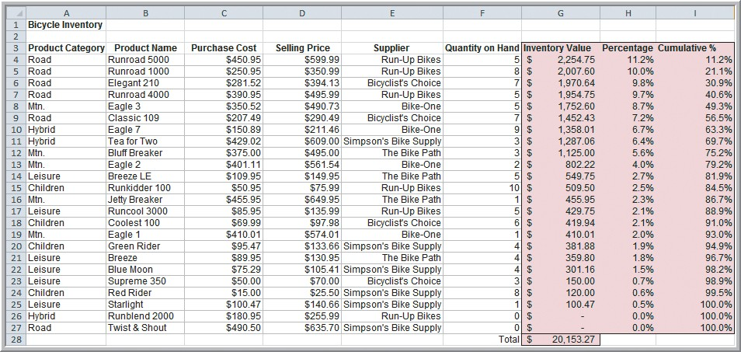
Applying Pareto Analysis to Bicycle Inventory
75% of the bicycle inventory value comes from 40% (9/24) of items.

Slide 16
Filtering Data
Auto Filter: simple criteria
Advanced Filter: more complex criteria
In Purchase Order Excel file
extract all records corresponding to the item Bolt- nut package.
Identify all records whose item cost is at least
$200
Filter by Bolt-nut package followed by order date and select all orders processed in September.

Slide 17

Discovering Value -doubts
of Data Analysis at Alders International
Duty free operations at airports, seaports, etc.
Maintain a data warehouse to track point-of-sale information and inventory levels.
Pareto analysis revealed that 80% of profits were generated from 20% of their product lines.
Allows selective elimination of less profitable items.

Slide 18
Statistical Methods for Summarizing Data -doubts
A statistic is a summary measure of data.
Descriptive statistics are methods that describe and summarize data.
Microsoft Excel supports statistical analysis in two ways:
Statistical functions
Analysis Toolpak add-in
Statistical methods are essential to Business Analytics

Slide 19
Frequency Distribution for Categorical Data
A frequency distribution is a table that shows the number of observations in each of several nonoverlapping groups.
Categorical variables naturally define the groups in a frequency distribution.
The purchase orders are placed for
Airframe fasteners Shielded Cable/ft. Side Panel
Electrical Connector Control Panel Machined Valve Door Decal
Bolt-nut package Pressure Gauge O-Ring
Hatch Decal Gasket Panel Decal

Slide 20
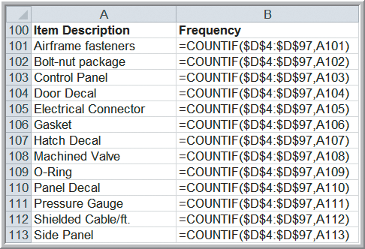
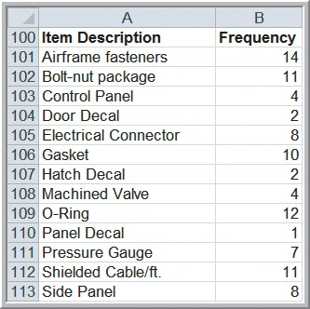
Constructing a Frequency Distribution for Items in the Purchase Orders Database

Slide 21
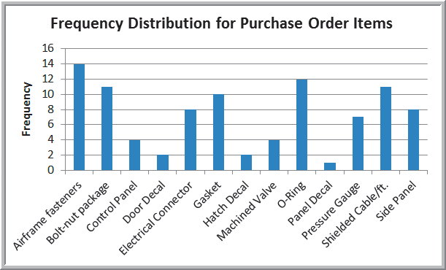
Constructing a Frequency Distribution for Items in the Purchase Orders Database

Slide 22
Relative Frequency Distribution
It is to express frequencies as a fraction, or proportion of the total.
If a data set has n observations, the relative frequency of category I is computed as
relative frequency of category i = frequency of category i
n
A relative frequency distribution is a tabular summary of the relative frequencies of all categories.

Slide 23
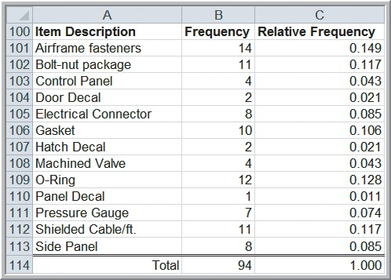
Relative Frequency Distribution for Items Purchased
Compute relative frequencies by dividing each frequency by 94.

Slide 24
Excel Histogram Tool
A graphical depiction of a frequency distribution for numerical data in the form of a column chart is called a histogram.
Click the Data Analysis tools button in the Analysis group under the Data tab in the Excel menu bar and select Histogram from the list.
Input range : data
Bin range: groups used for the frequency distribution
Check output box to display the histogram.
Create a frequency distribution and histogram for the A/P terms variable in the Purchase Orders database.

Slide 25
Percentiles
Standardized tests used for college or graduate school entrance examinations (SAT, ACT, GMAT, GRE etc)
Percentiles specify the percent of other test takers who scored at or below the score of a particular individual.
The kth percentile is a value at or below which at least k percent of the observation lie.
Excel function PERCENTILE.INC(array,k) computes kth percentile of data where k is in the range 0 to 1.
Rank and Percentile tool
Calculate the 90th percentile

Slide 26
Quartiles
Quartiles break the data into four parts
25th percentile is called the first quartile Q1. One fourth of data fall below Q1
50th percentile is called the second quartile. Half of the data fall below Q2.
75th percentile is called the third quartile Q3. Three fourth are below Q3.
100th percentile is called the fourth quartile Q4.
Excel function QUARTILE.INC(array, quart) is used to compute quartiles. Quart is between 1 and 4.
Compute the quartiles for cost per order data in the Purchase Orders database.

Slide 27
Cross Tabulations
It is a tabular method that displays the number of observations in a data set for different subcategories of two categorical variables.
It is often called contingency table
The subcategories of the variables must mutually exclusive and exhaustive.
Used in marketing research to provide insight into characteristics of different market segments using categorical variables such as gender education level, marital status and so on.

Slide 28
Exploring Data Using PivotTables
It allows to create custom summaries and charts of key information in the data.
They can be used to quickly create cross- tabulations and to drill down into a large set of data in numerous ways.
Create a cross tabulation of region sales by product using SalesTransaction database
Column – product
Row : region
Values – sum of customer id
Filter - payment

Slide 29
Summary
Making sense of large quantities of disparate data is necessary not only for gaining competitive advantage in today’s business environment but also surviving data.
Data Visualization is important for building decision models and for interpreting their results.
Frequency distribution, histograms, and cross- tabulations are tabular and visual tools of descriptive statistics.

